Slide 1
SSW-555: Agile Methods for Software Development
DevOps
Instructor: Dr. Nafiseh Ghorbani
Department of Systems and Enterprises
Stevens Institute of Technology

Slide 2

Acknowledgements
Some of the material in these slides is from a talk by David Myers

Slide 3

Today's topics
What is DevOps?
What problem are we trying to solve?
Evolution from Waterfall to Agile to DevOps
How is DevOps related to Agile?
DevOps principles
DevOps tools

Slide 4
Module overview: DevOps
DevOps is an application lifecycle that not only includes application development but incorporates the operation of the application.
DevOps promotes collaboration across application and operations disciplines and includes requirements, development, and deployment operations.
Module Outcomes
As a result of this module, you will be able to do the following:
Compare and contrast DevOPS vs. other Agile methodologies.
Evaluate the limitations of Agile in reference to software operations.

Slide 5
Module overview: DevOps
As we go through the slides, you will learn about the 5 key principles of DevOps, which include Collaboration and Communication, Automation, Continuous Integration and Continuous Delivery (CI/CD), Monitoring and Feedback, and Infrastructure as Code (IaC).
These principles aim to streamline the software delivery process and ensure faster, more reliable releases.
Many of these concepts are from other Agile methods, while a few are unique to DevOps.
As you listen, consider the following:
What concepts does DevOps take from other Agile methodologies?
What concepts are new to DevOps?
Are there missing roles?

Slide 6
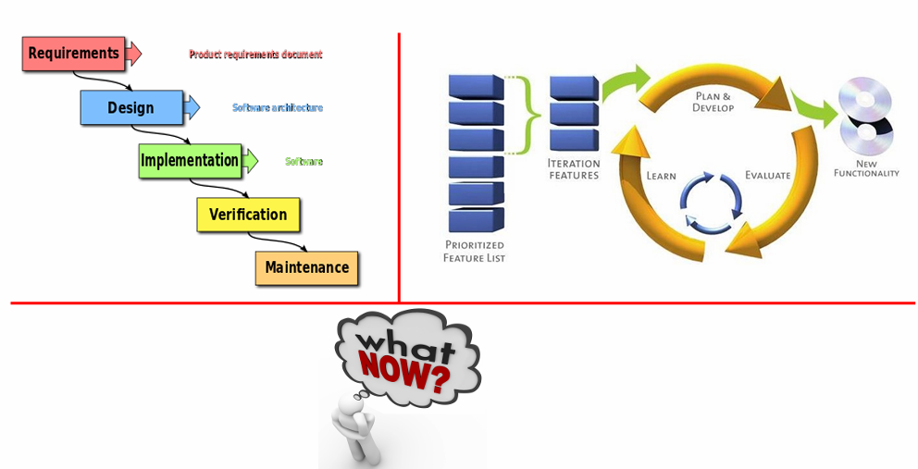
SDLC evolution: What now?
We improved the Waterfall model with Agile Methods

Slide 7
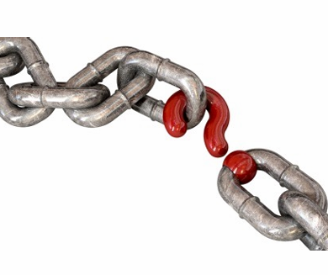
Delivering value to the customer
Agile methods help to build new features more quickly
But, we don’t achieve value until we deliver to customers
How to deliver those features to customers more quickly?

Slide 8
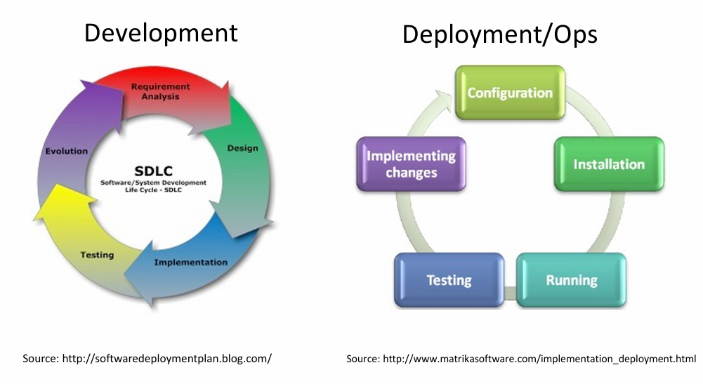
Development vs. Deployment/Ops

Slide 9
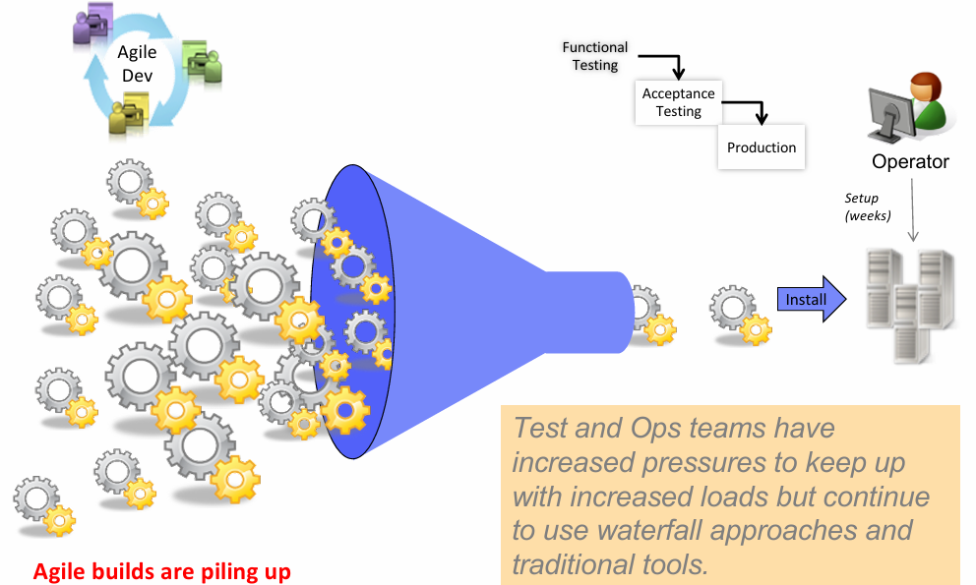
Agile is not enough…

Slide 10
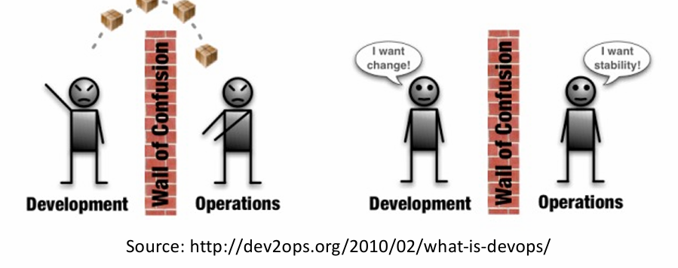
Application Lifecycle Management

Slide 11
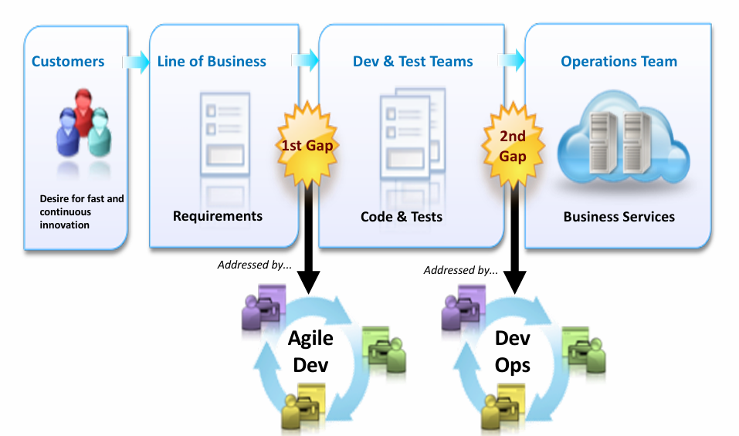
Siloed delivery challenges

Slide 12

How often to release new features?
Operating systems, mission critical systems
DSDM and SAFe minimize customer disruption by pacing releases
How frequently can the customer absorb new releases?
Web based services
Spotify: weekly releases
Feature toggles and
Limited blast radius
Amazon: 50M, deployments in 2014, (1.5/second)
Amazon deployed new code or changes to production 50 million times in 2014.
That averages out to 1.5 deployments per second across its infrastructure.
Netflix, Facebook

Slide 13
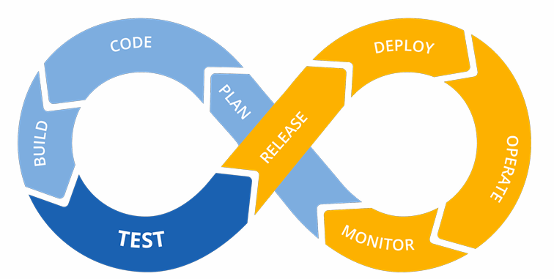
DevOps Solution
Tear down the silos!
Break down barriers between teams (e.g., Dev, Ops, QA, Security).
Promote cross-functional collaboration instead of isolated workstreams.
Encourage shared responsibility for the product lifecycle, from development to deployment.
Improve communication and transparency across departments.
Reduce handoffs and delays that occur when teams work in isolation.
Breaking down silos = Encouraging collaboration, communication, and shared responsibility across teams.

Slide 14
DevOps Solution
Re-integrate IT to deliver business value faster and better
Align IT teams with business goals to ensure technical work drives real value.
Adopt unified workflows that span development, operations, and business stakeholders.
Use shared tools and platforms for continuous integration, deployment, and monitoring.
Foster a culture of collaboration between developers, operations, and business units.
Enable end-to-end visibility into the value stream from idea to production.

Slide 15
DevOps Solution
To deliver business value faster and better
Accelerate delivery cycles with automation, CI/CD, and agile practices.
Improve quality and stability through collaboration and early feedback.
Respond quickly to changes in market or customer needs.
Continuously improve based on metrics, feedback, and retrospectives.
Deliver features that matter because everyone is focused on the same business outcomes.

Slide 16
The Five Key Principles of DevOps
Collaboration and Communication
DevOps emphasizes the importance of seamless communication and collaboration between development, operations, and other departments involved in the software lifecycle.
By breaking down silos, teams can work more efficiently, share insights, and solve problems faster, ultimately improving the quality and speed of software delivery.
Automation
Automation is a core principle of DevOps, focusing on automating repetitive tasks, such as code integration, testing, deployment, and infrastructure management.
By automating these processes, DevOps helps reduce human error, speed up workflows, and ensure consistent, reliable outcomes.
Automation tools like CI/CD pipelines, configuration management, and containerization play a significant role in this process.

Slide 17
The Five Key Principles of DevOps
Continuous Integration and Continuous Delivery (CI/CD)
Continuous integration involves regularly merging code changes into a shared repository, followed by automated builds and testing to detect issues early.
Continuous delivery takes this a step further by ensuring that the code is always in a deployable state, making it easy to release updates rapidly and safely.
These practices help reduce time-to-market and improve the frequency of software releases.
Monitoring and Feedback
Continuous monitoring and feedback are essential in DevOps for identifying performance issues, bugs, or inefficiencies in real time.
By actively monitoring applications, infrastructure, and user interactions, teams can detect problems early and make improvements.
Feedback loops provide the insights necessary for continuous improvement, ensuring that software is both performant and meets user needs.

Slide 18
The Five Key Principles of DevOps
Infrastructure as Code (IaC)
Infrastructure as Code involves managing and provisioning infrastructure through code rather than manual processes.
This allows for consistent, repeatable, and scalable infrastructure management.
IaC helps teams automate the setup and configuration of environments, ensuring that both development and production environments are consistent and easily replicable, reducing configuration drift.

Slide 19
Module overview: DevOps
As we go through the slides, you will learn about how DevOps has several repeatable and reliable processes for software releases.
With DevOps, the goal is to have releases occur frequently, so the right process is critical to automate as much of the process as possible.
Typically, manual processes are slow and error prone.
As you listen, consider the following:
What process do you think is the most impactful?
What aspects of continuous delivery could be improved over time?
Are there missing roles?

Slide 20
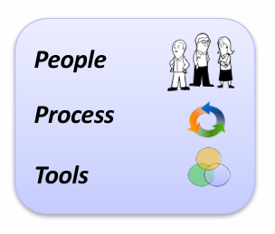
DevOps is…
A set of principles, values, and tools that facilitate collaboration across disciplines to…
Enable rapid evolution of deployed business services
Reduce risk, decrease cost, and improve quality

Slide 21
DevOps principles and values
Collaborate across disciplines
Requirements, development, deployment, operations
Develop and test against a production-like system
Iterative and frequent deployments using repeatable and reliable processes
Continuously monitor and validate operational quality characteristics
Amplify feedback loops

Slide 22
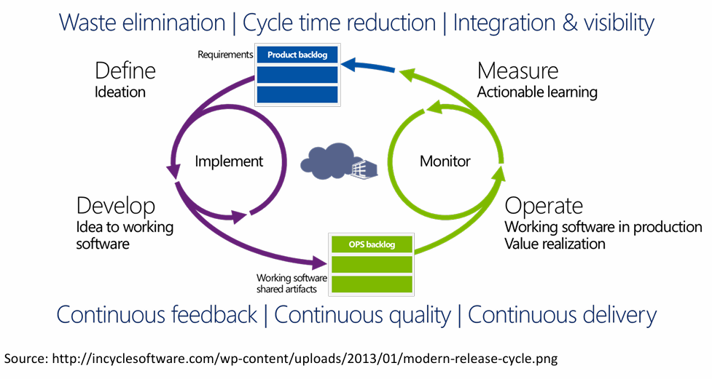
Application Lifecycle Management

Slide 23
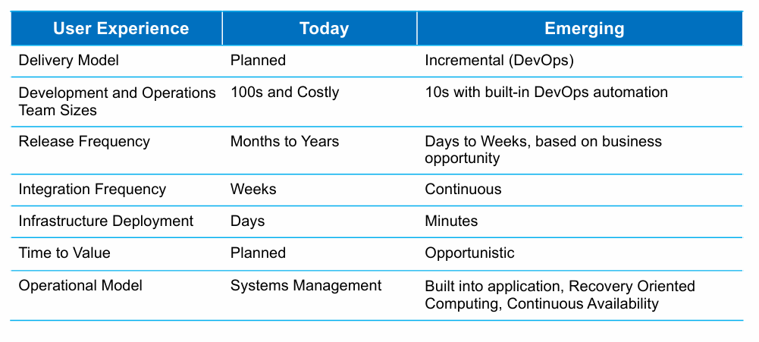
Evolving customer and market expectations

Slide 24
A DevOps Manifesto
We are uncovering better ways of running systems by doing it and helping others do it. Through this work we have come to value:
Individuals and interactions over processes over tools
Reliable and repeatable processes are critical to OPS
Working systems over comprehensive documentation
Working systems, not just working software
Customer and developer collaboration over contract negotiation
Customers, developers, and OPS must be partners
Responding to change over following a plan
That is, while there is value in the items on the right, we value the items on the left more.

Slide 25
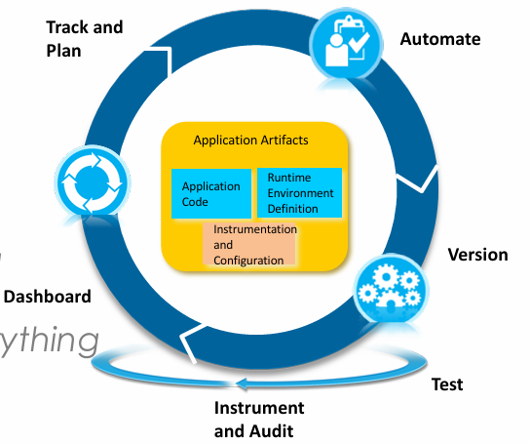
How do we make this happen?
Automate everything
Automate builds, tests, deployments, infrastructure provisioning, and monitoring.
Reduces manual errors, increases speed, and ensures consistency.
Examples: CI/CD pipelines, Infrastructure as Code (IaC), automated rollback.

Slide 26
How do we make this happen?
Version everything
Track changes in code, configuration, infrastructure, and documentation using version control (e.g., Git).
Ensures traceability, rollback capabilities, and collaboration.
Treat everything as code — not just application code but also environments.

Slide 27
How do we make this happen?
Test everything
Apply automated testing at all levels: unit, integration, system, acceptance.
Shift testing left to catch issues early in the development cycle.
Enables confident and safe deployments with faster feedback loops.

Slide 28
How do we make this happen?
Track and Plan everything
Use tools like Jira, Azure Boards, or GitHub Projects to manage work.
Helps prioritize, coordinate, and track progress of features and fixes.
Promotes transparency and alignment between Dev and Biz teams.

Slide 29
How do we make this happen?
Instrument and Audit everything
Add monitoring and logging at every layer app, infra, and user behavior.
Enable auditing and traceability for security, compliance, and debugging.
Observability helps understand system health and root causes.

Slide 30
How do we make this happen?
Dashboard everything
Visualize key metrics like deployment frequency, lead time, error rates, and system health.
Real-time dashboards help make data-driven decisions and spot issues quickly.
Promotes accountability and shared understanding across teams.

Slide 31
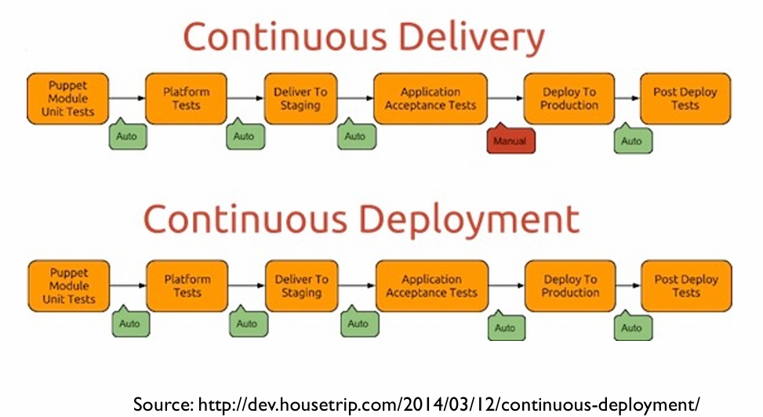
Continuous Delivery vs Deployment

Slide 32
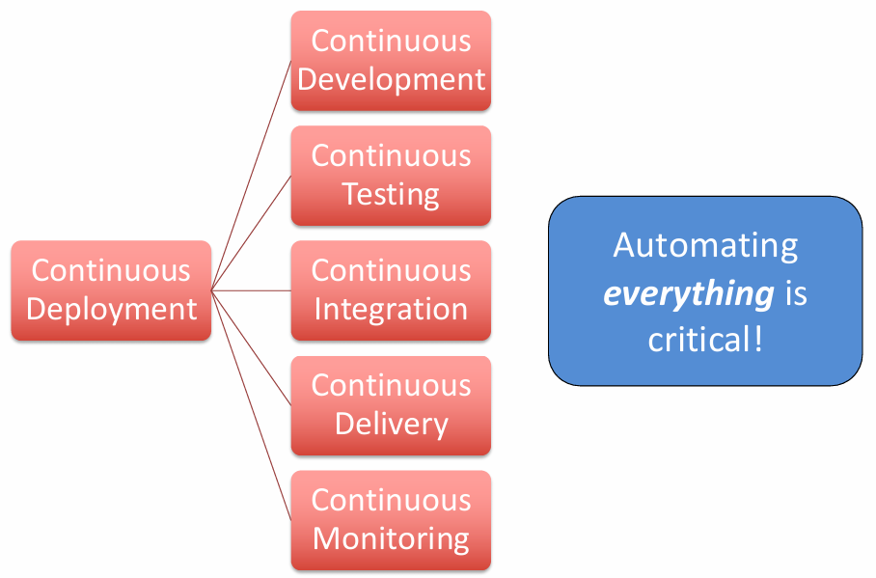
Continuous Deployment Requirements

Slide 33

Continuous Delivery Principles
Create a repeatable and reliable process for software releases
Releases occur frequently so the right process is critical
Automate as much of the process as possible
Manual processes are slow and error prone
Identify and automate the hardest parts
Keep everything needed to recreate the build under version control
You may need to recreate any previous build

Slide 34
Continuous Delivery Principles
Build quality in (Lean)
Include quality improvements up front, don’t just measure after the fact
Automated testing of all steps is critical
You’re not “done” until the feature is released
Everyone shares responsibility for delivery, not just Ops
Reflection and continuous improvement are critical

Slide 35
DevOps Tools and Practices
Source Control/Configuration Management
Keep everything needed to deliver a release under source control
Build tools
Developers’ build environment should reflect deployment
Completely automate the build process including all steps
Build, stage, and test every time a change is committed to source control
Automated test
All testing must be automated, e.g. TDD
Unit, integration, system, performance, security, acceptance

Slide 36
DevOps Tools and Practices
Continuous Integration
Integrate and test after every commit
Identify problems quickly
Develop, integrate, and test against a production-like environment

Slide 37
DevOps Tools and Practices
Monitoring
Critical to monitor everything relevant
Code quality, complexity, coverage
Mean time to failure
Mean time between failures
Mean time to resolution
Server capacity: disk, memory, network
User behavior
Response times
Real-time monitoring

Slide 38
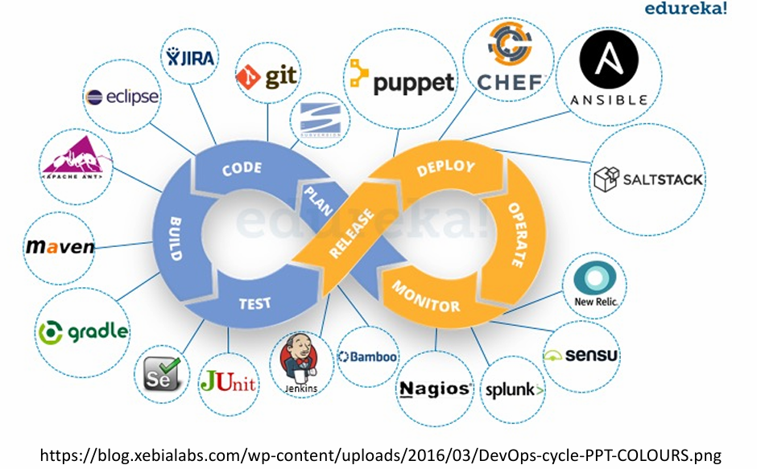
Tools for continuous deployment

Slide 39
DevOps summary
DevOps extends Agile principles from code to include systems and operations
DevOps is a philosophy
Continuing evolution between developers and operations

Slide 40

Questions?

